Slide 1
Study Session 8 Wearable Systems and Equipment
Report PT 100-10 and 100-13
Ulrike Haltrich
AGS Meeting 28 September 2016 Frankfurt

Slide 2
Study Session 8
PT 100-10 Stage 0 project on wearable systems and equipment
To collect use cases on wearable systems and equipment and identify opportunities for additional standardization in TC100 on the topic
To produce a technical report and to create an NP if possible as the outcome
Co-Project leaders:
Ms. Ulrike Haltrich (DE)
Mr. Junichi Yoshio (JP)
Experts:
Mr. Hong Zhang (CN)
Ms. Li Wang (CN)
Ms. Janina Laurila-Dürsch (DE) (replaced by Ms. Iris Straszewski)
Ms. Dr. Kate Grant (UK)
2

Slide 3
Study Session 8
PT 100-13 Stage 0 project on user comfort and evaluation of smart textiles and wearables
To study user comfort aspects of smart textiles and wearables;
To prepare a market analysis including trends;
To identify standardization needs;
To contribute to the work of IEC SG 10 Wearable Smart Devices; and
To prepare a first working draft
Project leader:
Ms. Ulrike Haltrich (DE)
Experts:
Ms. Zhao Xiaoying (CN); Mr. Pekka Talmola (FI); Mr. Tomoo Nishigaki (JP)
3

Slide 4
SS 8 Meeting on 29 Sept. 2016
Report of SMB/SG 10 Smart Wearable Devices (U. Haltrich)
Report of use case studies JP NC (J. Yoshio)
Update wearable standardization activities in other regions (All)
Stage 0 Project Wearables user comfort and evaluation (U. Haltrich)
Definition of Scope and Outline of DTR
Status report, NP on Listening Functionality (J. Yoshio)
Status report, DTR IEC 63071 Power supplying scheme for wearable system and equipment (J. Yoshio)
JTC 1 Wearables trend report (K. Grant)
4

Slide 5
Trends
5
Source: Report of SMB/SG 10 Smart Wearable Devices

Slide 6
Definitions of smart wearables device
wearable smart devices | electronic devices and components intended to be located near, on or in an organism that have intelligent functionality and/or may be a part of an intelligent system via connectivity
near-body electronics | electronic devices and components intended to be located near an organism where it does not contact the external surface of the organism directly
on-body electronics | electronic devices and components intended to be located on an organism where it contacts the external surface of the organism directly
in-body electronics | electronic devices and components intended to be located internal to an organism
electronic textile | fabrics or textile-based electronic devices and components
6
Source: Report of SMB/SG 10 Smart Wearable Devices

Slide 7
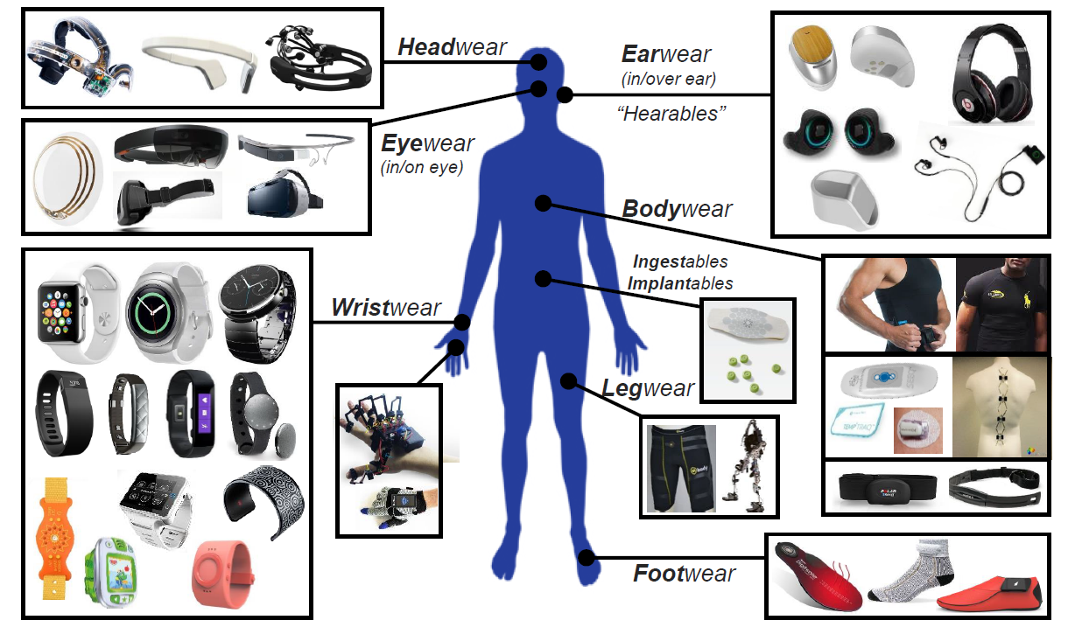
Wearables smart devices and textiles
source: Dr Harry Zervos, www.IDTechE.com, presentation at Workshop Standards for Wearable Technology & Textile Electronics, March 8, 2016, Raleigh, NC
7

Slide 8
Draft Scope of DTR User comfort and evaluation of smart textiles and wearables
This document addresses concerns and aspects related to user comfort which provide barriers to a continued use of wearable smart devices and smart textiles. The objective of this document is to address challenges of emerging smart textiles and wearable smart devices which may prevent the adoption and acceptance in different vertical application domains. It can be used by stakeholders as a reference in the development and design of smart textiles and wearable smart devices. It also includes considerations related to health, safety, data protection and privacy. The document aims to promote further standards development related to usability, performance and user interfaces of wearable smart devices and smart textiles.
8

Slide 9
Vertical application domains
Fashion
Communication
Lifestyle computing
Sport/Fitness
Wellness
Medical and active assisted living (AAL)
Security/Safety
Automotive
9

Slide 10
Next steps
Combine results of PT 100-10 and 100-13 into one TR as deliverable
Discuss and define scope and outline of DTR
Add use case scenarios in annex of DTR
Launch NP in Spring 2017
10

