Slide 1
Proposal for developing TR: Conceptual model for TC 100 robotics
T. Inokuchi and Y. Komachi
2016-09

Slide 2
1. Background
1.1 Beginning of the discussion of multimedia robotics
TC 100 secretary proposed the topic of multimedia robotics as an anticipated topic of future Study Session in the AGS, 2012-10.
See document: 100/AGS497(item 5.2(3), 2012-10)
1.2 Preliminary study
AGS secretary studied and reported multimedia robotics technology from the TC 100 point of view.
See document: 100/AGS534(2013-06), 100/AGS556(2013-09), 100/AGS583(2014-05), 100/AGS632(2015-04), 100/AGS660(2015-10)

Slide 3
1. Background
1.3 Guideline for operating Study Session
AGS secretary proposed the Guideline for operating Study Session.
See document: 100/AGS610(2014-11), 100/AGS629(2015-04)
1.4 Call for membership
AGS secretary circulated a call for membership for discussing multimedia robotics.
See document: 100/AGS687(2016-05)
The Minimum requirement for the number of members was satisfied in 2016-09.
1.5 SMB/ACART
SMB/ACART reported its activity.
See document: 100/AGS692(2016-09), 100/AGS710(2016-09)

Slide 4
2. Report of SMB/ACART
Robotics is very multi- and inter-disciplinary; involving electromechanical technology, control and automation, information and communication technology, as well as mobility and navigation.
Due to the fact that there are many standardization organizations related to robotic technology, the guideline will be prepared in as transparent a way as possible, involving different standardization organizations and experts from different technical fields.
The goal of ACART is to complete the guideline by the end of 2017.

Slide 5
3. Proposal for developing TR
Considering the background in the AGS discussion and responding the report of ACART, AGS/SS 7 should develop a
TR: Conceptual model for TC 100 standardization on multimedia robotics technology.

Slide 6
Scope of the TR
This document describes a conceptual model for multimedia robotics. The conceptual model is specified from the standardization point of view in order to clarify the functionality of multimedia robotics components and the relationships between them and to define multimedia robotics services.
The model provides the key technology to be standardized in multimedia robotics. It should be noted that the modeling is not intended for actual implementation of a system or system components for multimedia robotics. The modeling is expected to be used as a reference for discussing and developing new standardization work on multimedia robotics and, therefore, to contribute to the expansion of the international and domestic markets for multimedia robotics.

Slide 7
4. Outline of the TR
Working draft should be discussed in the stage 0 project for the TR.
The followings will be a trigger for the discussion:
1 Scope
2 Normative references
3 Terms and definitions
4 TC 100 position in robotics
5 Classification for robotics technology
6 Prioritized issues to be standardized

Slide 8
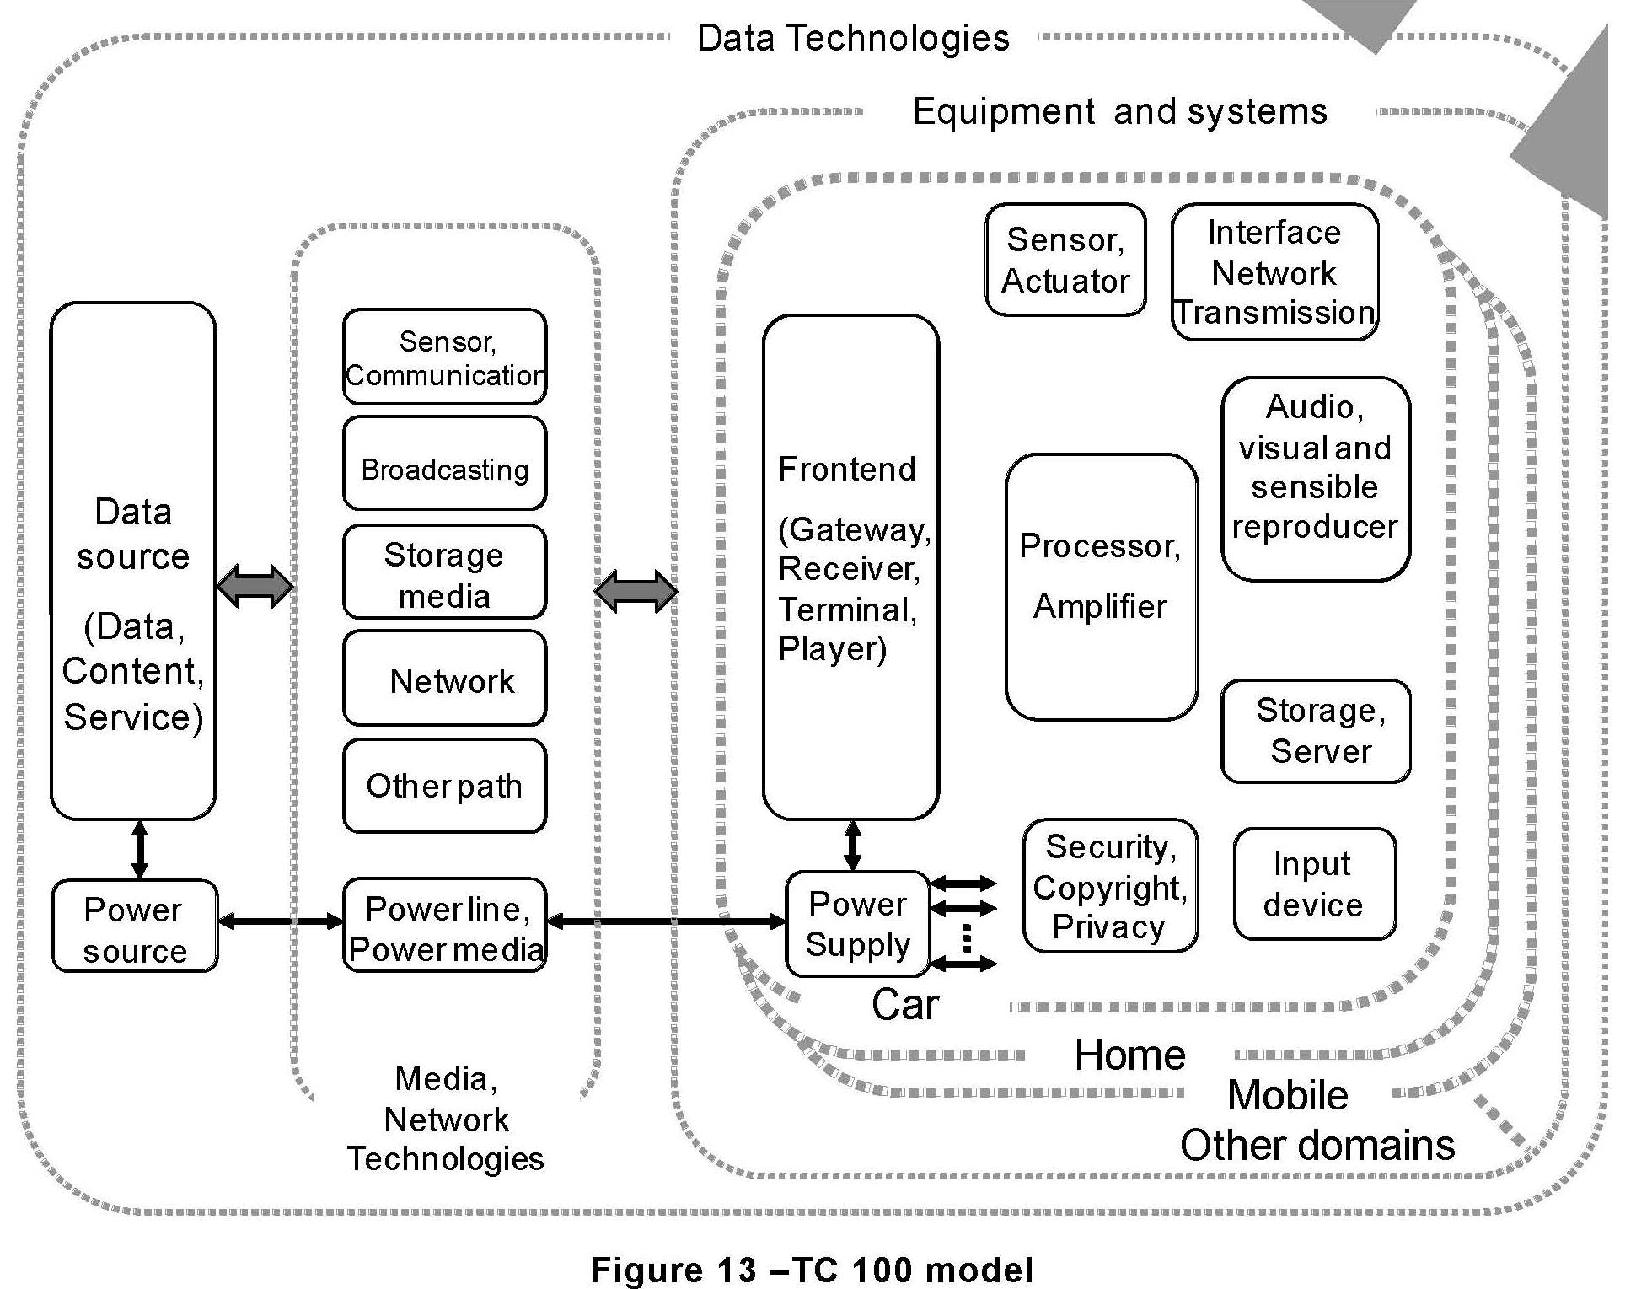
4. Outline of the TR
4 TC 100 position in robotics
TC 100 robotics can be aligned along with Home, Mobile, and etc. in Fig.13 of IEC TR 61998:2015 ed.2, Model and framework for standardization in multimedia equipment and systems.

Slide 9
4. Outline of the TR
5 Classification for robotics technology
In accordance with the Fig.13 of IEC 61998:2015, standardization items (100/AGS534(2013-06), 100/AGS556(2013-09), 100/AGS583(2014-05), 100/AGS632(2015-04), 100/AGS660(2015-10)) studied by AGS secretary can be classified as follows:
5.1 Audio, visual and sensible reproduce
- voice recognition
- image recognition
5.2 Input device / Sensor, Actuator
- measurement to recognize the position
- position information of robot

Slide 10
4. Outline of the TR
5 Classification for robotics technology
5.3 Interface / Network / Transmission / Communication
example: 100/AGS712(2016-09)
5.4 Input device
-
5.5 Storage / Server
- Storage Data Format
-
5.6 Processor / Application
multiple robots work as system by collaborating each other
-
5.7 Frontend (Gateway, Receiver, Terminal, Player)
-
5.8 Security, Copyright, Privacy
-

