Slide 1
SMB Strategic Group 5 (SG 5) Ambient Assisted Living (AAL)
Meeting Report, Frankfurt, 11-12 September 2012
Ulrike Haltrich
TC 100 AGS, Berlin, 22 October 2012

Slide 2
Scope and Definition of AAL
“To manage and coordinate Ambient Assisted Living (AAL) standardization work in IEC TCs, to establish and achieve interoperability and interconnectivity of AAL systems, and accessible design of their user interface.
AAL systems encompass products, services, environments and facilities used to support those whose independence, safety, wellbeing and autonomy are compromised by their physical or mental status.”
Note: For the definition of Accessible Design refer to ISO/IEC Guide 71

Slide 3
Strategic Group 5 (SG 5)
Convenor: Mr. T. Sentko DE
Members:
The Kick-Off Meeting of IEC/SG 5 took place in March 2012:
Status update of the countries involved
Information exchange about activities in different countries
Presentation of the Smart Grid Architecture Models which will be used in AAL environment
Workshop on day 2 to discuss different topics
Mr. D. Bannister UK-Member
Mr. P. Coebergh v.d.B. NL-Member
Mrs. P. Cunniffe NZ-Member
Mr. A. Delepoulle FR- Member
Mrs. K. Delort US-Member
Mrs. J. Laurila-Epe DE-Member
Mr. D. Ma CN-Member
Mrs. B. Novel ES-Member
Mr. A. Siani IT-Member
Dr. H. Yamada JP- Member
Mrs. K. Grant UK-Alternate
Dr. Y. Seki JP-Alternate
Mr. G. Ungaro FR-Alternate
Mr. E. Varela ES-Alternate
Mr. Z. Wu CN-Alternate
Dr. G. Fuchs TC59-Expert
Mrs. U. Haltrich TC100-Expert
Dr. K. Neuder TC62-Expert
Mr. J. Newbury TC57-Expert
Mr. KP. Wegge TC59-Expert

Slide 4
Key Drivers of AAL
Global concern about demographic change (e.g. China: 0.44 billion over 60 by 2030)
Definition of "elderly" varies: + 60 years in Europe and China, +75 years in Japan
Major sectors concerned by AAL are: healthcare, home appliances, multimedia, private and public buildings
Cost efficient healthcare will require keeping elderly people at home and developing communication with hospitals, doctors and other health support organization.
Data privacy is a key issue to be addressed by standardization.
Industry move into AAL market. This should be supported by standardization:
Improved cost/performance ratio by promoting global markets with standardized products/services
Ensure interoperability
Develop new types of products for the elderly e.g. assistance robots, home appliances, multimedia
AAL is a transversal issue which also concerns the usability of the products. AAL should be a mainstream technology rather than assistive technology.

Slide 5
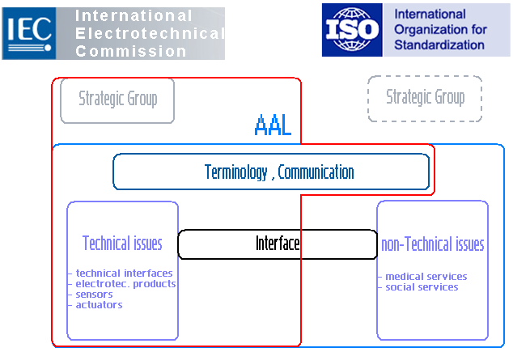
IEC/ISO – AAL Standardization
5

Slide 6
SG 5 – Working Area – Main Topics
Set up inventory of existing standards and standardization projects (inside and outside IEC)
Engage key stakeholders interested in AAL standardization work
Identify ISO/IEC TCs and SCs being concerned
Coordinate cross TC/SC work to prevent overlap of work or potential inconsistencies, liaise with ISO, ITU, and other organizations
Take into account economic aspects of AAL, e.g. by identifying international market potential, market drivers etc.
Develop roadmap with timeline that includes reference architecture and prospective standardization projects
It is not within the scope of SG 5 to write standards – this is assigned to the committees in and outside of IEC.

Slide 7
3 Teams of SG5
Status Team:
Collect information about AAL-standards
Identify existing IEC-standards
Identify fora and consortia to liaise with (e.g. Continua)
Security Team:
Deals with the aspects of data security
Modeling Team:
Define architecture model
Explore the model SG1 and SG3 are working with
Develop a use case model
Initiate a call for use cases
Next Meeting planned 4-5 Dec. 2012 (location t.b.c.)

Slide 8
SG 5 – Ongoing work - Next Steps
International AAL conference (possibly in 2014?)
Think about the intention of the conference, i.e.
Who should be addressed
Which organizations and guests should be invited?
Connection to/Interaction with EU Commission
Cooperation with Continua Health Alliance
Analyze projects in the AAL environment

