Slide 1
SMB Strategic Group 5 (SG 5)
Ambient Assisted Living (AAL)
Meeting Report, Frankfurt, 6-7 March 2012
Ulrike Haltrich
TC 100 AGS, Dallas, 15 May 2012

Slide 2
Participants
Present
Mr. T. Sentko Convenor
Mr. P. Sebellin Secretary
Members Excused
Mrs. K. Delort US-Member Mr. A. Delepoulle FR- Member
Mrs. J. Laurila-Epe DE-Member Mr. G. Ungaro FR-Alternate
Dr. K. Neuder TC62-Expert Dr. H. Yamada JP- Member
Dr. Y. Seki JP-Alternate Mr. Z. Wu CN-Alternate
Dr. S. Hirakawa JP-SMB Mrs. B. Novel ES-Member
Mr. D. Ma CN-Member Mr. J. Newbury TC57-Expert
Mr. D. Bannister UK-Member Mrs. K. Grant UK-Alternate
Mrs. P. Cunniffe NZ-Member Mr. P. Coebergh van den Braak NL-Member
Mr. A. Siani IT-Member
Mr. E. Varela ES-Alternate
TC/SC Members
Dr. G. Fuchs TC59-Expert
Mr. KP. Wegge TC59-Expert
Guests
Mrs. U. Haltrich TC100
Mr. S. Kossler
Mr. Ihmenkamp

Slide 3
Scope and Definition of AAL
To manage and coordinate Ambient Assisted Living (AAL) standardization work in IEC TCs, to establish and achieve interoperability and interconnectivity of AAL systems, and accessible design of their user interface.
AAL systems encompass products, services, environments and facilities used to support those whose independence, safety, wellbeing and autonomy are compromised by their physical or mental status.
Scope and definition will be submitted for approval to the SMB
Note: for the definition of Accessible Design refer to ISO/IEC Guide 71

Slide 4
Key Drivers of AAL
Demographic changes and ageing society
Need for Autonomous and Healthy Living of Elderly People at Home
Rising health care costs
Interoperability Requirements
Many R&D Projects
Early Business Practices
Standardisation Requirements

Slide 5
Summary of National Reports
Japan
  Demographics
  R&D Projects
  Early Business
China
  Demographics
  Household and Rehabilitation Industry
Germany
  Projects
  AAL Standardisation Roadmap

Slide 6
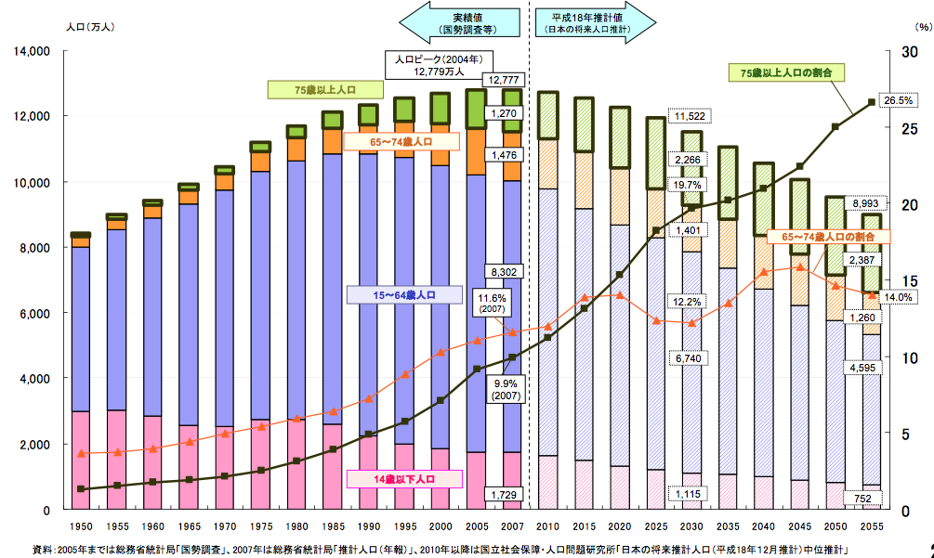
Japan
Japan has high proportion of elderly people
Population (x10,000)
Measured
Estimated
Rate (%)
Rate of over-75 (%)
In 2055, 1/4 population will be over 75 years old.
Over 75
65-74
In 2030, 1/5 population will be over 75 years old.
Rate of 65-74 (%)
15-64
In 2012, 1/8 population is over 75 years old.
0-14
Year

Slide 7
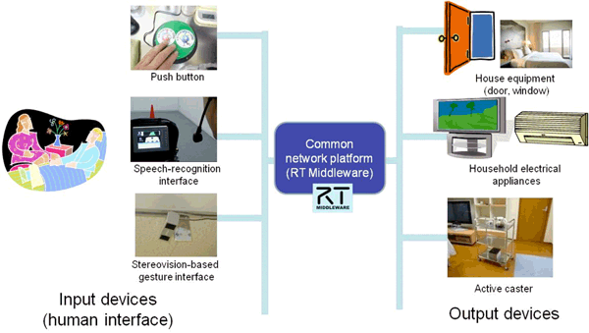
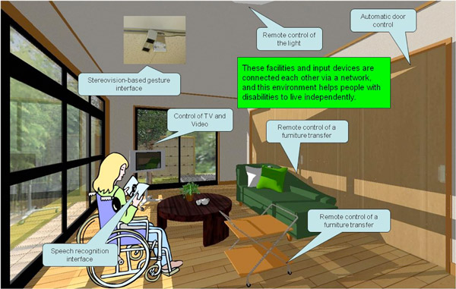
Example of R&D Project (1)
Robot Technology (RT) that assists independent living
Home environment can be customized
for each person with disabilities via RT Middleware.
Home Environment Models
for Comfortable and Independent Living of People with Disabilities (AIST)

Slide 8
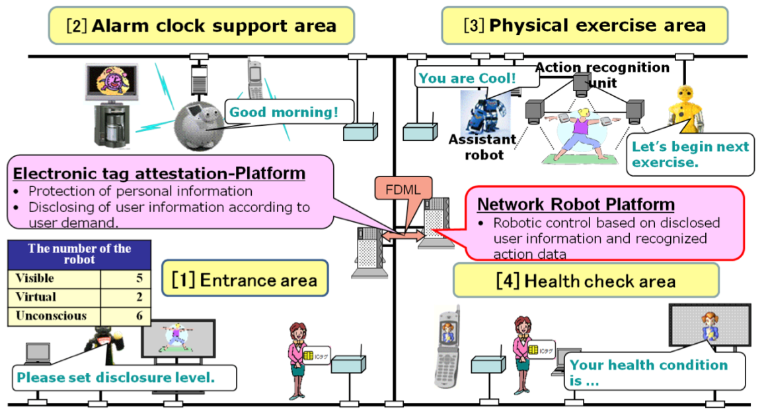
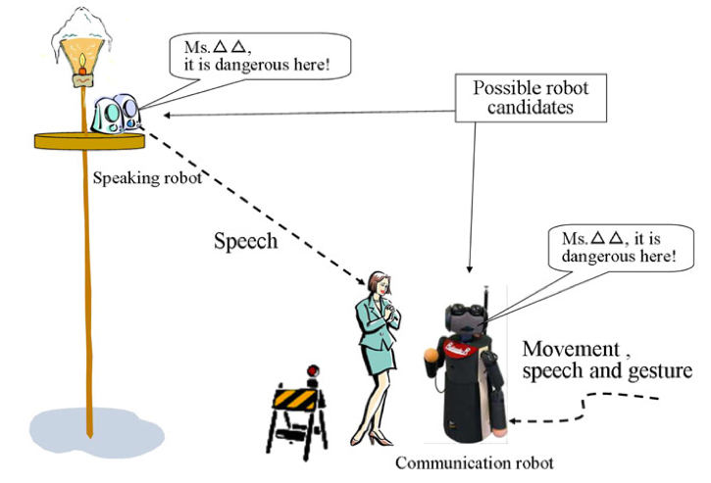
Example of R&D Project (2)
Robot Technology (RT) that assists independent living
Ubiquitous Network Robot Platform (UNR-PF)
A middleware that enables applications to perform services continuously by combining multiple robotic devices effectively across multiple areas.
UNR-PF applications and services in ubiquitous sensor network environment (ATR)

Slide 9



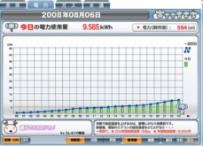





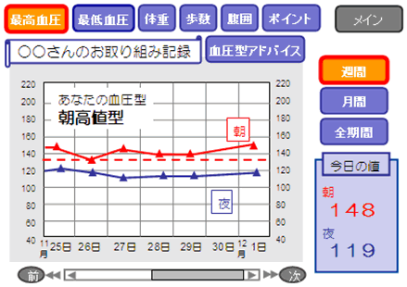




Example of R&D Project (3)
Home ICT services that assist living
Let’s check it!
OK, I will check your PC from our operation center remotely.
ＮＴＴ
Ooh, I forgot
to lock!
Reduce carbon
footprint!
おでかけモード
My PC does not
work well….
LOCK
LOCK
LOCK
OFF
Remote Support
customer
Home Security
Home Energy Management
NGN
Home
Gateway
Healthcare
Home
Gateway
Photo
Print!
Media Sharing
Daughter’s house
Father’s house
Schematic explanation of home ICT services (NTT)

Slide 10












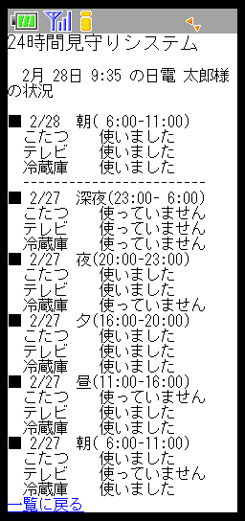









Example of R&D Project (4)
Home ICT services that assist living
Cloud-type service that watches daily activity rhythm and safety of older person.
Older person
Family, Caregiver, or NPO’s staff
Family
Support
↑
Evaluation
↑
Check
Caregiver / NPO’s staff
Door of entrance
or Refrigerator
Check the
daily activity rhythm
Check the
daily activity rhythm
・・・
ＮＥＣ
Website for Famiky
e-mail notification
↑
Anomaly detection
Website for Caregiver
/ NPO’s staff
Sensor to
open/close
Rules for
Evaluation
Sensor to monitor
the power
Open/Close
INTERNET
Access
point
On/Off
Router
・・・
Sending data of
two sensors
Watching
Server
Analysis of living
activities rhythm
Home electric appliances
“e-MIMAMORI (watching)” (NEC)

Slide 11
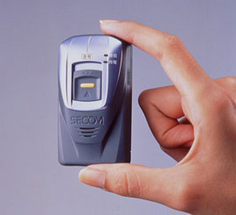
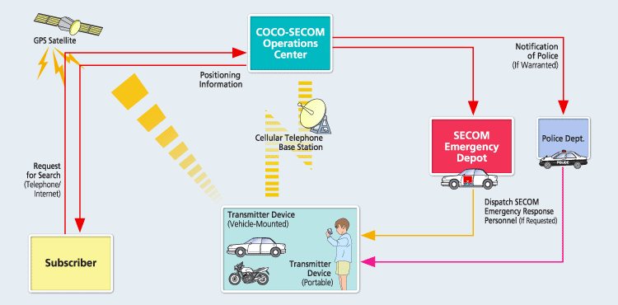
Early Business
Mobile ICT that locate the holder and dispatch security personnel in emergency
“COCO-SECOM” (SECOM)

Slide 12
China’s Ageing Society
China’s population 1.3 billion people (world population 6.7 billion)
People over 65 years will increase from 2006 (8%) to 2050 (24%) which corresponds to 322 mil. people
Families in China tend to be smaller, and aging people are more likely to live alone without their families
Aging society trend will largely change the traditional lifestyles of Chinese people, especially the lifestyles of aging people
In 2011, China has issued 12th five-year plan of aging society
  Social security, health, family construction, buildings, infrastructure
  Service (e.g. in their homes, communities, rehabilitation services)
  Standardization

Slide 13
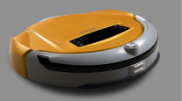
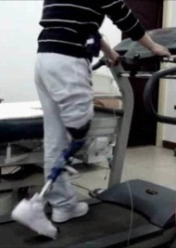
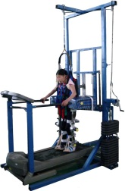
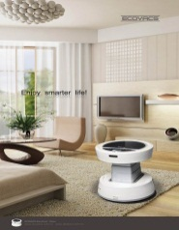
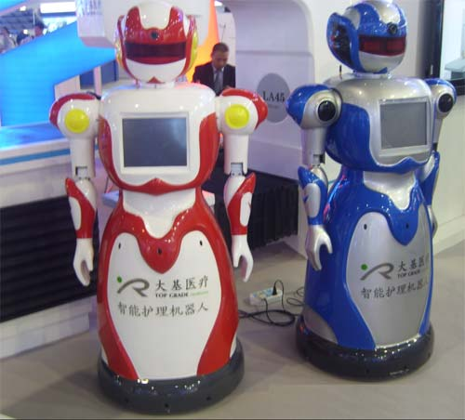
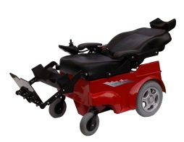
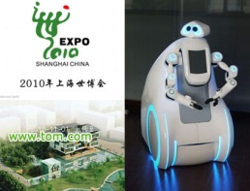
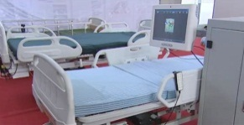
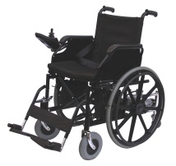
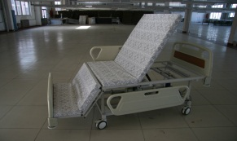
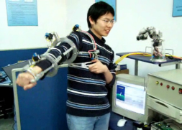
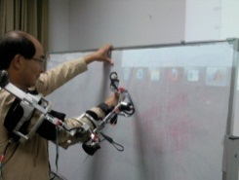
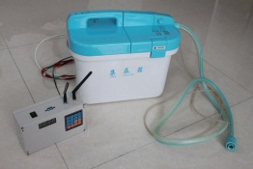
Household & rehabilitation industry in China
2. Robot floor cleaner
3. Smart lower prostheses
4. Smart mobile aid equipment
1. Robot air cleaner
7. Smart home and living ambient control robot
5. Smart wheelchair
6. Smart nursing robot
8.Smart nursing bed
9.Smart living aid equipment
10. Smart rehabilitation appliance robot

Slide 14
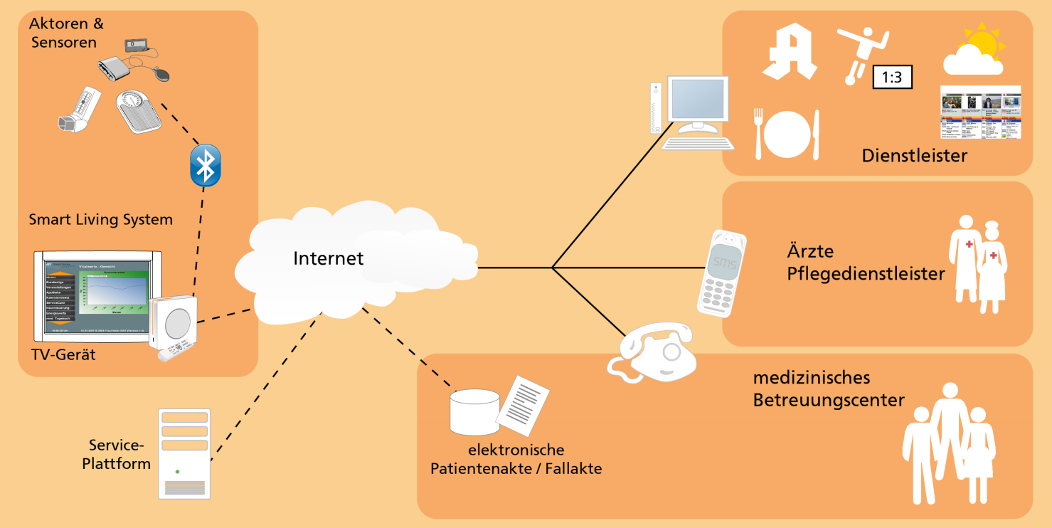
Example of R&D Project WohnSelbst in Germany
Development and testing of AAL concept incl. service and technology elements to support senior citizens for healthy aging their homes
Adaptation and development of existing and future technologies for a private funded system (without social security subsidies)

Slide 15
Project Roadmap AAL Interoperability (RAALI)
Research project funded by the German Federal Ministry of Education and Research
Duration 24 months, started 1 July 2011
Goal is development of methods, components and interfaces for the implementation of interoperable AAL systems
RAALI works on three topics
  Development of a German national roadmap for AAL interoperability
  Development of integration profiles for AAL systems
  Market overview of available AAL middleware platforms
Notes:
Interoperability, i. e. the capability of AAL systems and components to work together, is one essential requirement for successful market introduction of AAL systems

Slide 16


universAAL open platform and reference Specification for AAL
Seventh Framework Programmme
* Duration: 48 months * Start: February 2010
* Budget: 13.9 M€ * EU Funding: 10.5 M€
Provide open technological platform that facilitates the development and deployment of a board range of AAL services
Approach: Consolidate and extend work of earlier projects
Instead of each AAL service being built from scratch for specific needs – establish a single “standard” way to build AAL applications

Slide 17








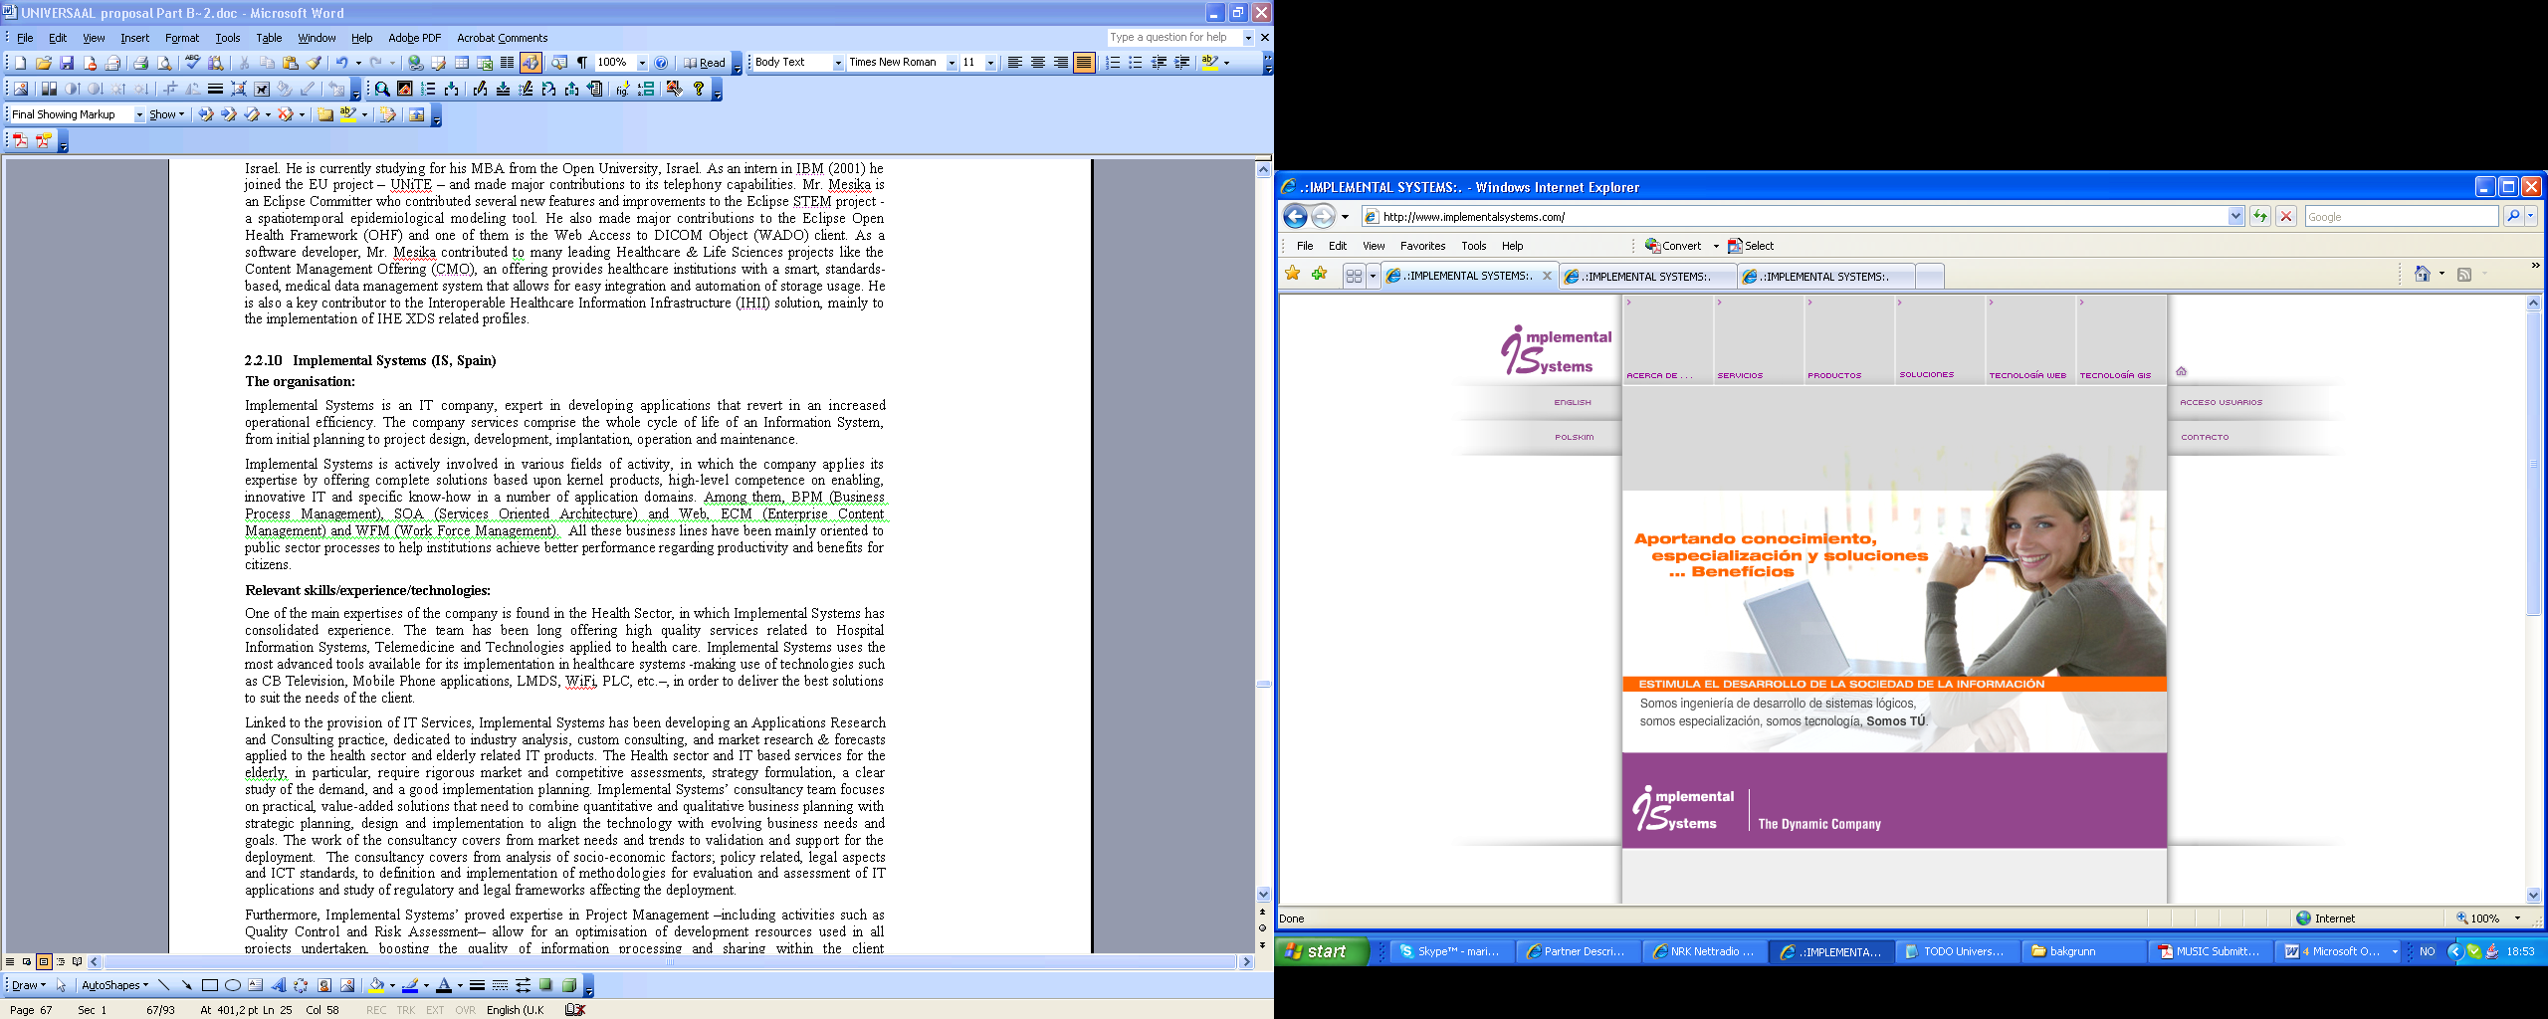










Achievements so far
Team established
Gathered and consolidated “use cases”
Draft reference architecture available
First versions of tools + demonstrator + video available
Contacting other projects / other organizations; established AALOA community
Partner:
CERTH

Slide 18
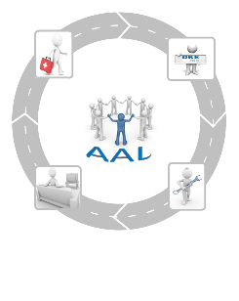
German AAL Standardization Roadmap (developed by DKE)
German AAL standardization Roadmap describes
Status of AAL
Political, social and regulatory framework
Definition of requirements of AAL systems
Analysis and identification of relevant standards and specifications
    sensors and actuators
    user interfaces
    middleware/services/runtime platform
    standards and specifications for operator models
    building information modeling
    use case centered integration profiles

Slide 19
German AAL Standardization Roadmap Recommendations
Dismantle trade barriers
Promote interoperability
Need of standards for interoperability of AAL components
Extend existing standards for interoperability
Need of standards for remote maintenance and quality assurance of AAL-systems and components
Need of consistent semantics to describe AAL components
Need of use case-centered integration profiles
  useful for the identification of AAL-systems and –components

Slide 20
Break-out sessions
How do we attract stakeholders for AAL?
Which types of stakeholders would be necessary to succeed?
Who are the existing market drivers (international, national)?
Is it possible to define business models for AAL services?
Are there regulations on national level?
Reference Architecture: is the smart grid layer approach a potential model?

Slide 21
Results of Break-out Sessions
SG5 Proposed Projects and Structure
Status Team
Collect information about AAL-standards
Identify existing IEC-standards
Identify fora and consortia to liaise with (e.g. Continua)
Security Team
Deals with the aspects of data security
Modeling Team
Define an architecture model
Explore the model SG1 and SG3 are working with
Develop a use case model
Initiate a call for use cases
Next Meeting planned 11-12 Sept. 2012 (location t.b.c.)

